Slide 1

Time Series Analysis
Time’ is the most important factor which ensures success in a business. It’s difficult to keep up with the pace of time. But, technology has developed some powerful methods using which we can ‘see things’ ahead of time!
Nope, not the time machine, we are talking about the methods of prediction & forecasting. As the name ‘time series forecasting’ suggests, it involves working on time (years, days, hours, minutes) based data, to derive hidden insights to make informed decision making.

Slide 2
Importance of Time Series Analysis
Most businesses work on time series data to analyze
Sales numbers for the next year
Website Traffic
Competition Position
Demand of products
Stock Market Analysis
Census Analysis
Budgetary Analysis
This is just the tip of the iceberg and there are numerous prediction problems that involve a time component and concepts of time series analysis come into picture

Slide 3
Time series data is data that is collected at different points in time. This is opposed to cross-sectional data which observes individuals, companies, etc. at a single point in time.
Because data points in time series are collected at adjacent time periods there is potential for correlation between observations. This is one of the features that distinguishes time series data from cross-sectional data.
Time series data can be found in economics, social sciences, finance, epidemiology, and the physical sciences.
Field | Example topics | Example dataset
Economics | Gross Domestic Product (GDP), Consumer Price Index (CPI), S&P 500 Index, and unemployment rates | U.S. GDP from the Federal Reserve Economic Data
Social sciences | Birth rates, population, migration data, political indicators | Population without citizenship from Eurostat
Epidemiology | Disease rates, mortality rates, mosquito populations | U.S. Cancer Incidence rates from the Center for Disease Control
Medicine | Blood pressure tracking, weight tracking, cholesterol measurements, heart rate monitoring | MRI scanning and behavioral test dataset
Physical sciences | Global temperatures, monthly sunspot observations, pollution levels. | Global air pollution from the Our World in Data

Slide 4
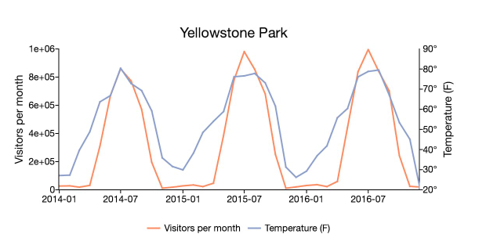
Time series data is a collection of quantities that are assembled over even intervals in time and ordered chronologically.
The time interval at which data is collection is generally referred to as the time series frequency.
For example, the time series graph above plots the visitors per month to Yellowstone National Park with the average monthly temperatures.
The data ranges between January 2014 to December 2016 and is collected at a monthly frequency.

Slide 5
But what makes a time series more challenging than say a regular regression problem? There are 2 things:
Time Dependence of a time series - The basic assumption of a linear regression model that the observations are independent doesn’t hold in this case.
Seasonality in a time series - Along with an increasing or decreasing trend, most time series have some form of seasonal trends, i.e. variations specific to a particular time frame.

Slide 6
Univariate Versus Multivariate Time Series Models
Time series models may also be split into univariate time series models and multivariate time series models. Univariate time series models are models used when the dependent variable is a single time series. Trying to model an individual’s heart rate per minute using only past observations of heart rate and exogenous variables is an example of a univariate time series model.
Multivariate time series models are used when there are multiple dependent variables. In addition to depending on their own past values, each series may depend on past and present values of the other series. Modeling U.S. gross domestic product, inflation, and unemployment together as endogenous variables is an example of a multivariate time series model.

Slide 7
Regression vs Time Series Forecasting
Short Answer:
Time-series forecast is Extrapolation.
Regression is Intrapolation.
Longer version
Time-series refers to an ordered series of data. Time-series models usually forecast what comes next in the series - much like our childhood puzzles where we extrapolate and fill patterns.
Time-series may or may not be accompanied with other companion series which usually can be seen as occurring-together. Sometimes, the prediction is also applied for these companion series… Such problems are referred to as ‘Multivariate Timeseries’
Apart from all these, Time-series could also be accompanied by Exogeneous variables which are very much like companion series…. but they are not predicted because it is something exogeneous to the System. Their future values will be specified when we are making the prediction for the Target series. For e.g. while doing sales forecast, the variable whether we will be running promotions on TV at that time is an Exogeneous variable. The predictions can be made by specifying different values for them.
Regression can be applied to Time-series problems as well. e.g. Auto-regression
But Regression can also be applied to non-ordered series where a target variable is dependent on values taken by other variables. These other variables are called as Features. When making a prediction, new values of Features are provided and Regression provides an answer for the Target variable. Essentially, Regression is a kind of intrapolation technique.

Slide 8
Can we use linear regression for Time Series Data ?
Of course we can use linear regression with time series data as long as:
The inclusion of lagged terms as regressors does not create a collinearity problem.
Both the regressors and the explained variable are stationary
Your errors are not correlated with each other
The other linear regression assumptions apply
No autocorrelation is the single most important assumption in linear regression. If autocorrelation is present the consequences are the following:
Bias: Your “best fit line” will likely be way off because it will be pulled away from the “true line” by the effect of the lagged errors.
Inconsistency: Given the above, your sample estimators are unlikely to converge to the population parameters.
Inefficiency: While it is theoretically possible, your residuals are unlikely to be homoskedastic if they are autocorrelated. Thus, your confidence intervals and your hypothesis tests will be unreliable.
In conclusion, if you are trying to use the model to predict sales, I’m not sure it is useful, even as a “simplistic” model.
You may want to use an auto regressive model instead. It has the advantage of likely fitting your data much better than a straight line and you are more likely to reliably link present sales to past sales than just the passage of time.

Slide 9
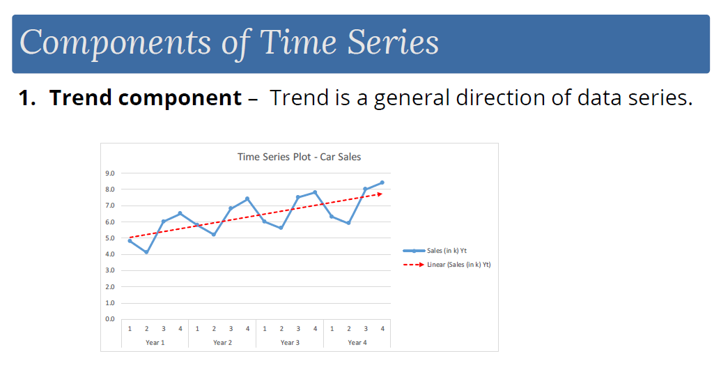

Slide 10
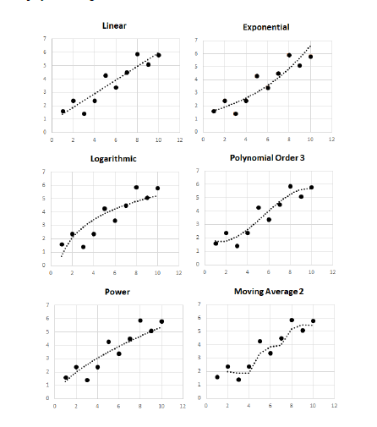
Increase or decrease in the series over a long period of time.
Example- Australian energy production data shows a linear, upward trend. Trend can be constant, linear, exponential, quadratic, polynomial, logarithmic etc.

Slide 11
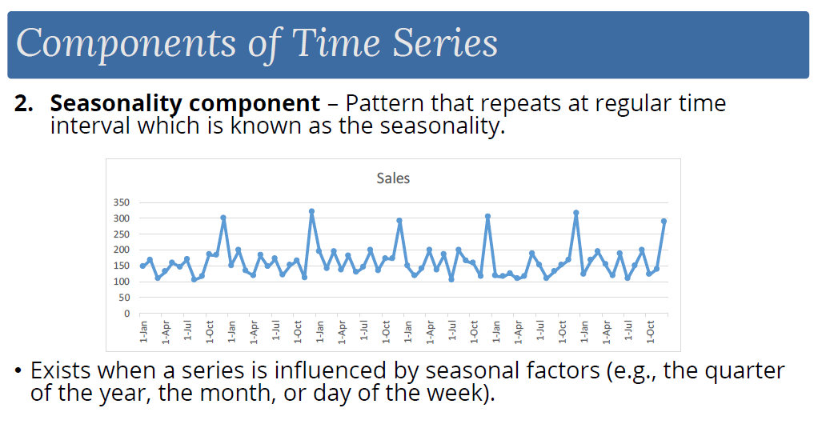

Slide 12
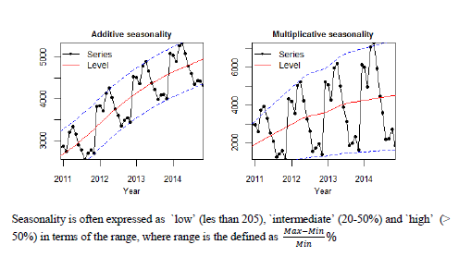
Regular pattern of ups and down fluctuations. It is a short-term variation due to seasonal factors as time of the year or day of the week. Example- Sales at Amazon increases on Thanksgiving day and New Year’s Eve every year. Seasonal variation is also known as periodic. Seasonality can be additive or multiplicative. Additive seasonality is when the values in different seasons vary by a constant amount, and multiplicative seasonality is when the values in different seasons vary by a constant degree. Multiplicative seasonality increases as the level increases.

Slide 13
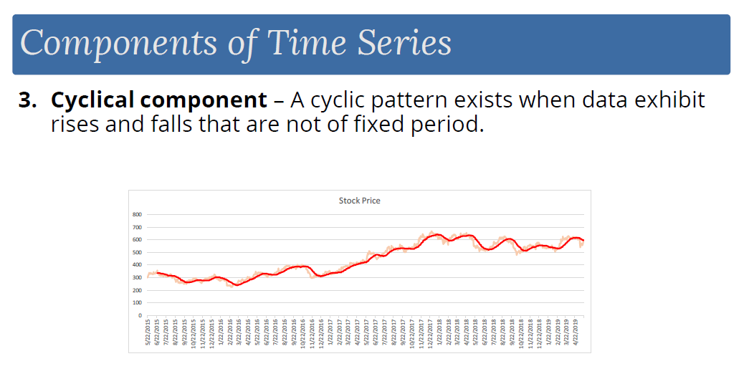

Slide 14
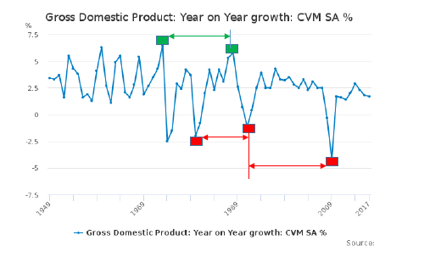
Medium term variation caused by circumstances repeating at irregular interval. Example- 5 years of economic growth, followed by 2 years of slump, and again 7 years of growth. Cyclicality may or may not be present in the data. Average length of a cycle is usually longer than that of seasonality and the average magnitude of cycle is usually more variable than that of seasonality. The YOY growth of GDP of UK.

Slide 15
Cyclicity Vs. Seasonality
A cyclical component means the pattern is repeated at irregular intervals and that the period when it reoccurs is over a year, and the outcome may change from one cycle to another.
A seasonal component is in which a certain pattern is repeated after a regular period of time, and the recurrence is usually less than a year.
After saying this, we can conclude that seasonal component is more predictable than the cyclical one. The cyclical component is not constant, but the seasonal is constant more or less.

Slide 16
It is important to understand the difference with the help of examples:
Seasonal components: The average air fares generally increase during the festive months of a year. this is mainly due to fact that people travel more during the festive months. Either they go for a vacation or they visit their hometown if they are residing elsewhere.
Thus, the time series of the average air fares would show a peak during the festive months. As this pattern is repeated at a constant interval, this is a seasonal component and hence it is easier to predict when the air fare increase.
Cyclical component: Let us consider the time series of amount of the saving that an individual can make in a month, starting from the day he earns. Generally, we would observe an increasing trend in this time series till the day he marries. Once he has a family to support the savings rate would come down and stabilize after some time. Next, when he has child, the saving rate would again take a decreasing trend because now he has one more member to support. Now this time series would exhibit a cyclical trend because the recurrence period is not fixed. Different individual marry at different ages.

Slide 17
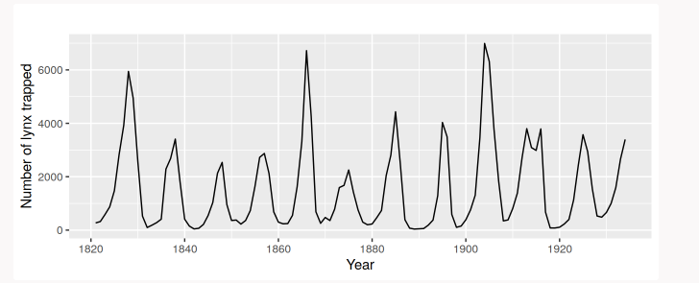
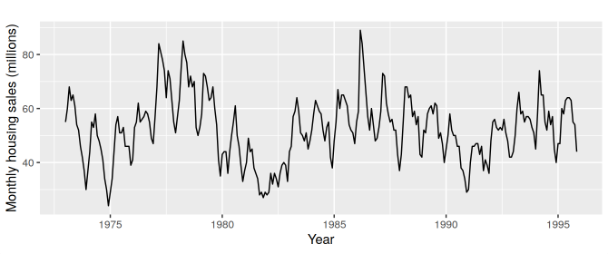
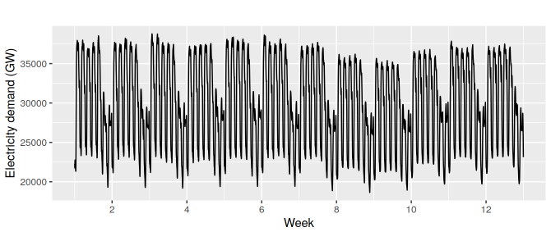
The plot here shows clear aperiodic population cycles of approximately 10 years. The cycles are not of fixed length – some last 8 or 9 years and others last longer than 10 years.
The middle plot shows strong sea­son­al­ity within each year, as well as some strong cyclic behav­iour with period about 6 – 10 years.
Here there are two types of seasonality – a daily pattern and a weekly pattern. If we collected data over a few years, we would also see there is an annual pattern. If we collected data over a few decades, we may even see a longer cyclic pattern.

Slide 18
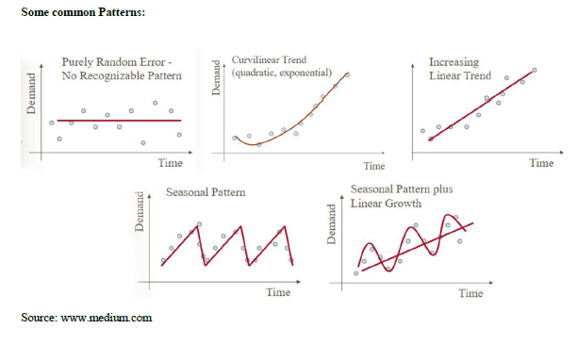

Slide 19
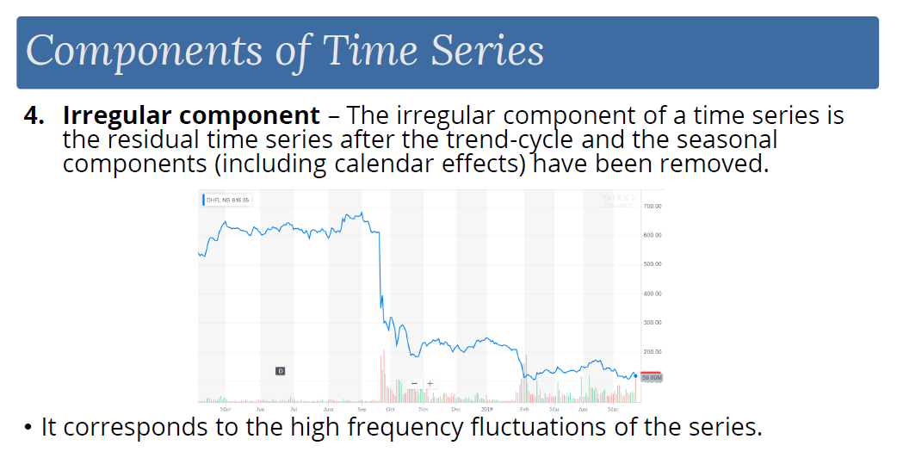

Slide 20
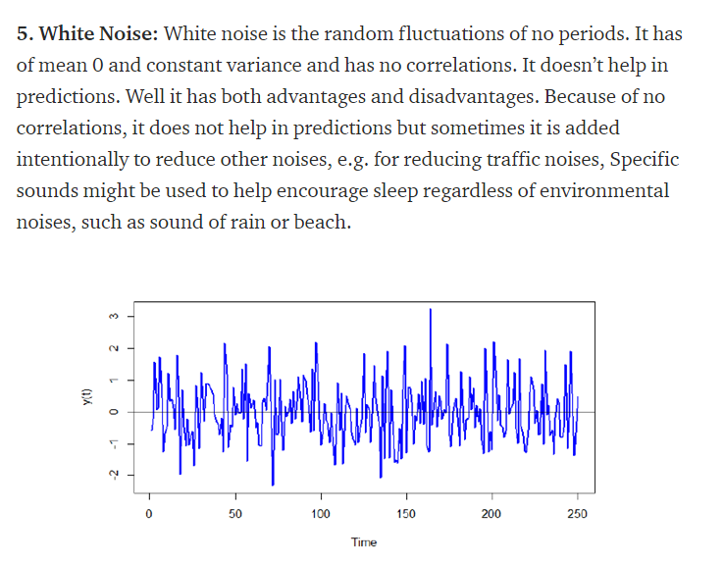

Slide 21
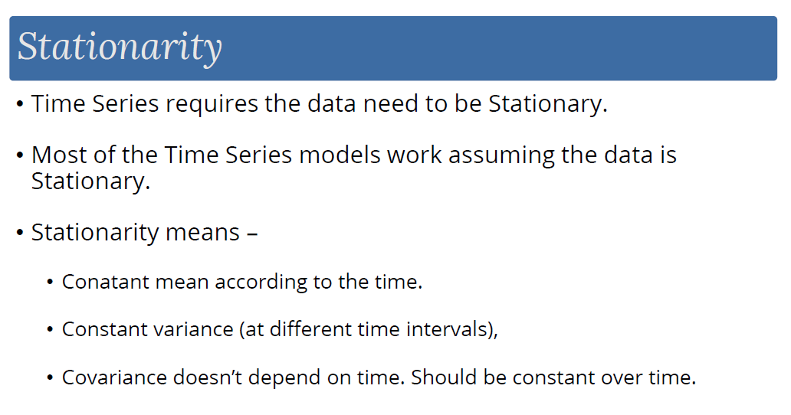

Slide 22
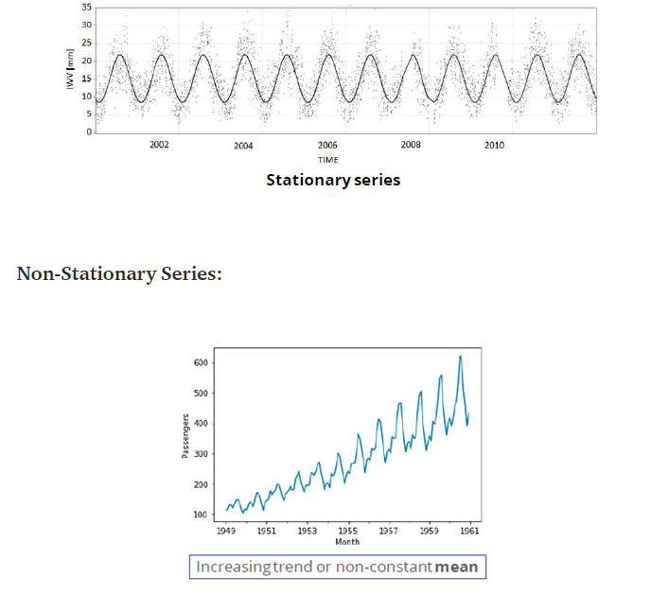
Reference Courtesy: Medium.com

Slide 23
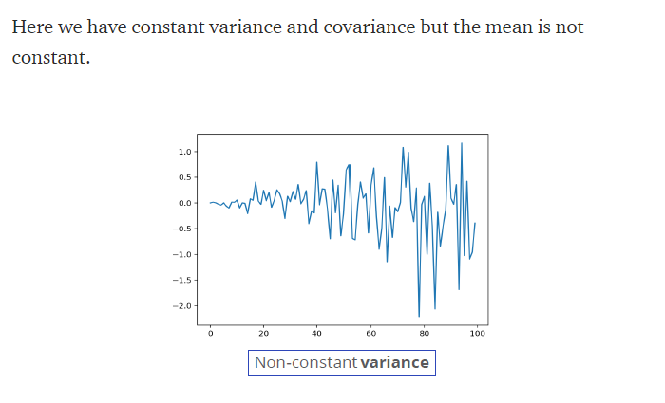
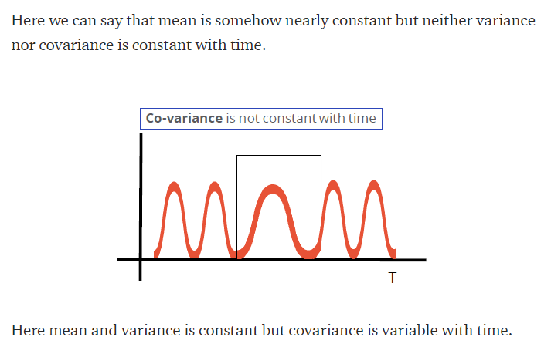
Reference Courtesy: Medium.com

Slide 24
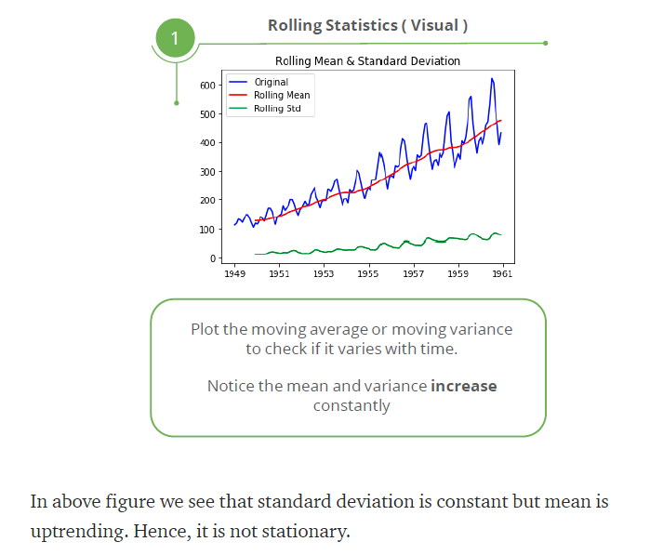
Plotting Rolling Statistics:
We can plot the moving average or moving variance and see if it varies with time. By moving average/variance I mean that at any instant ‘t’, we’ll take the average/variance of the last year, i.e. last 12 months.
For the series to be stationary,
both the mean and standard deviation have to be constant with time, i.e. parallel to x-axis.
Reference Courtesy: Medium.com

Slide 25
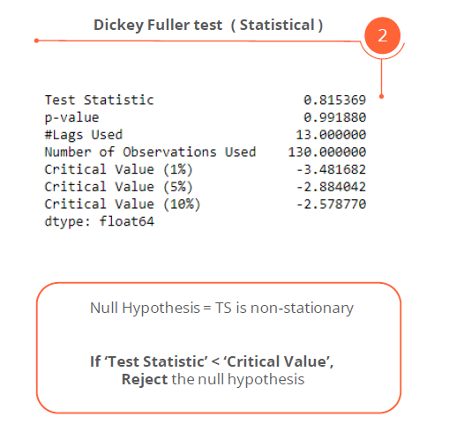
Dickey-Fuller Test: This is one of the statistical tests for checking stationarity. Here the null hypothesis is that the TS is non-stationary. The test results comprise of a Test Statistic and some Critical Values for difference confidence levels. If the ‘Test Statistic’ is less than the ‘Critical Value’, we can reject the null hypothesis and say that the series is stationary.
Reference Courtesy: Medium.com

Slide 26
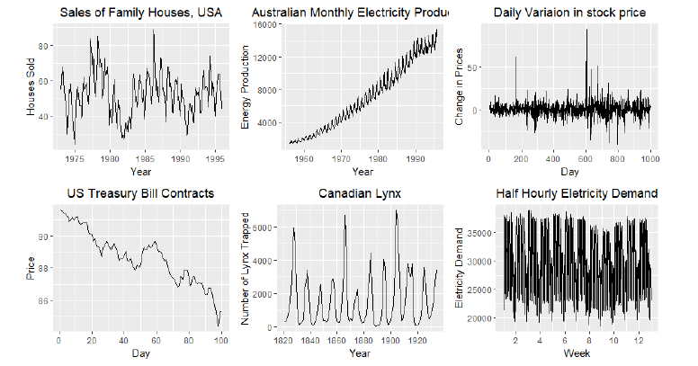
Identify the time series components

Slide 27
Fig 1 (The monthly housing sales) –
Strong seasonality within each year, as well as some strong cyclic behaviour with a period of about 6–10 years. There is no apparent trend in the data over this period.
Fig 2 (Australian Energy Production) –
Increasing trend with string seasonality, no apparent cyclicality
Fig 3 (Daily Variation of Stock Price) –
Pure Noise, no trend, seasonality or cyclicity
Fig 4 (US Treasury Bill)-
No seasonality, clear downward trend in the 100 days
Fig 5 (Canadian Lynx) –
Cycles of variable length, on average approx. 10 years
Fig 6 (Half Hourly Electricity Demand) –
Daily and weekly seasonality

Slide 28
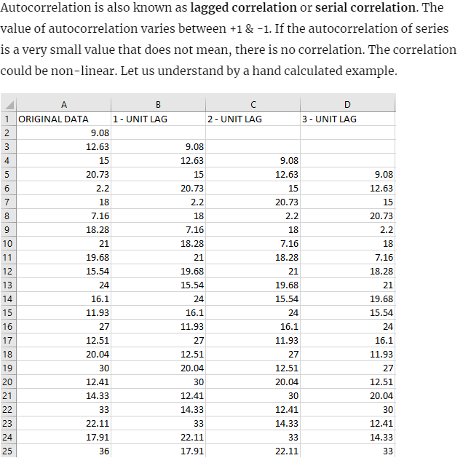
Autocorrelation is a mathematical representation of the degree of similarity between a given time series and the lagged version of itself over successive time intervals.
In other words, instead of calculating the correlation between two different series, we calculate the correlation of the series with an “x” unit lagged version (x∈N) of itself.

Slide 29

How to make a non-stationary time-series stationary?
There are a couple of ways to achieve stationarity through data transformation like taking log10, loge, square, square root, cube, cube root, exponential decay, time shift.
2 different methods by which a non-stationary time series can be converted to time-series.
1) Differencing: The p-value (>0.05) indicates that we cannot reject the null hypothesis and hence series is non-stationary. Differencing is performed by subtracting the previous observation from the current observation or we can say, by subtracting previous day demand from current day demand.
By differencing, stationarity can be achieved easily. This means time-series does not depends on time. It’s like white noise, no matter when we observe it looks same at any point of time. Whereas, trends and seasonality affect the time-series at different times. Stationary time-series does not have any predictable pattern.

Slide 30


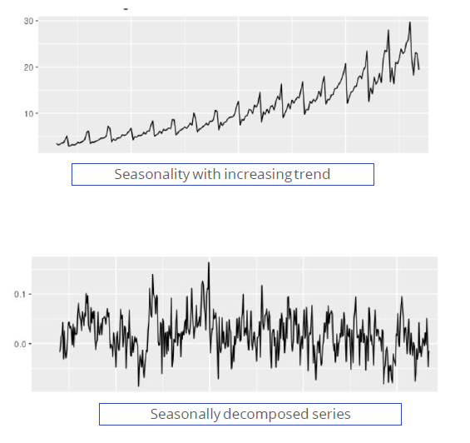
2) Decomposition of time-series: decomposition removes the trending and seasonality pattern by decompose any non-stationary time-series into trend, seasonal and some random error (having zero mean and correlated over time). We analyse the random error or irregular pattern as stationary component.
Decomposition model is also of two types:
Additive Decomposition:
Product Decomposition:
Reference Courtesy: Medium.com

Slide 31
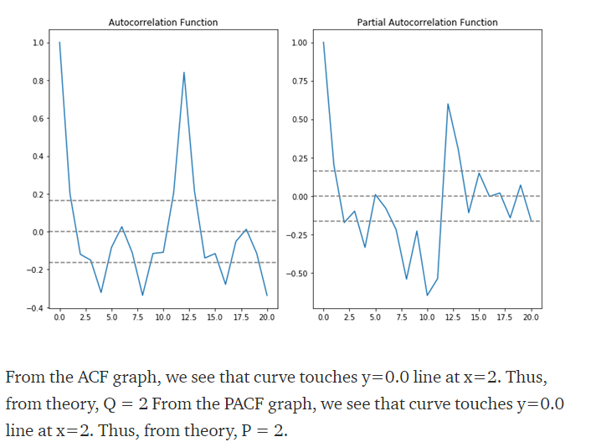
Plotting ACF and PACF:
Auto-correlation function (ACF):
Auto-correlation refers to the way the observations in a time series are related to each other. ACF is the coefficient of correlation in time-series between the value of the point at current time and its value at lag k, i.e. correlation between y(t) and y(t-k). ACF identifies the order of MA process.
Partial auto-correlation function (PACF):
PACF is same as of ACF but the intermediate lags between y(t) and y(t-k) are removed (or partial out). i.e. correlation between y(t) and y(t-k) with (k-1) lags is removed.
Reference Courtesy: Medium.com

Slide 32
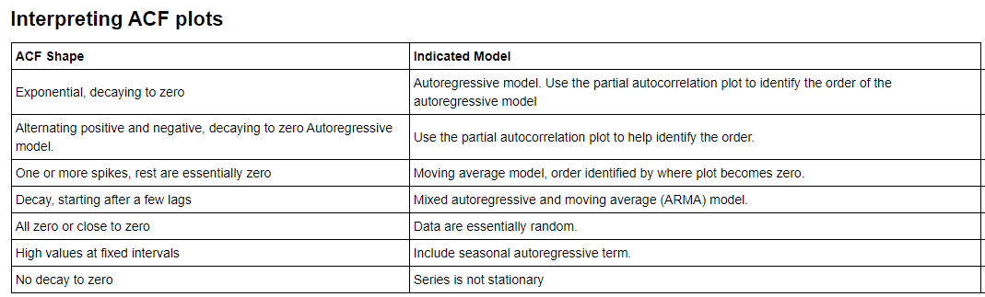
Reference Courtesy: Medium.com

Slide 33
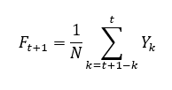
Simple Moving Average:
Moving Average is the simplest forecasting model in all time-series model. It forecasts the future value of a time-series data using average (or weighted average) of the past data.
Where F(t+1) is the forecasted value at time (t+1), N is the past observations.
In pandas rolling() and mean() functions are used to calculate moving average for a time window (or time period).
Note: simple moving average gives equal weight to all past observations used in forecasting the future value, which is its major drawbacks.

Slide 34

Time Series Model
Exponential Smoothing:
Assigns differential weight to past observations
Where alpha is the smoothing constant. Its value lies between 0 and 1. More the alpha value is, less the smoothing will be. ews() functions in pandas use to calculate exponential moving average using alpha as the parameter.

Slide 35
Time Series Model
Auto-Regressive Integrated Moving Average Models:
Auto-Regressive (AR) and Moving average (MA), both is used frequently for forecasting. AR and MA are combined to create models such as auto-regressive moving average (ARMA) and auto-regressive integrated moving average (ARIMA). ARMA models are regression models which means regression of a variable on itself measured at different time periods.

Slide 36
The ARIMA model is made up of three key components:
The autoregressive component is the relationship between the current dependent variable the dependent variable at lagged time periods.
The integrated component refers to the use of transforming the data by subtracting past values of a variable from the current values of a variable in order to make the data stationary.
The moving average component refers to the dependency between the dependent variable and past values of a stochastic term.

Slide 37
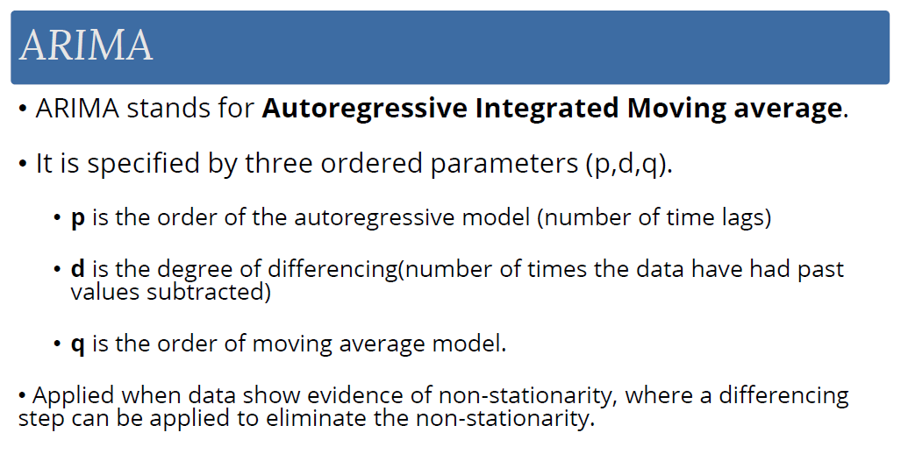

Slide 38
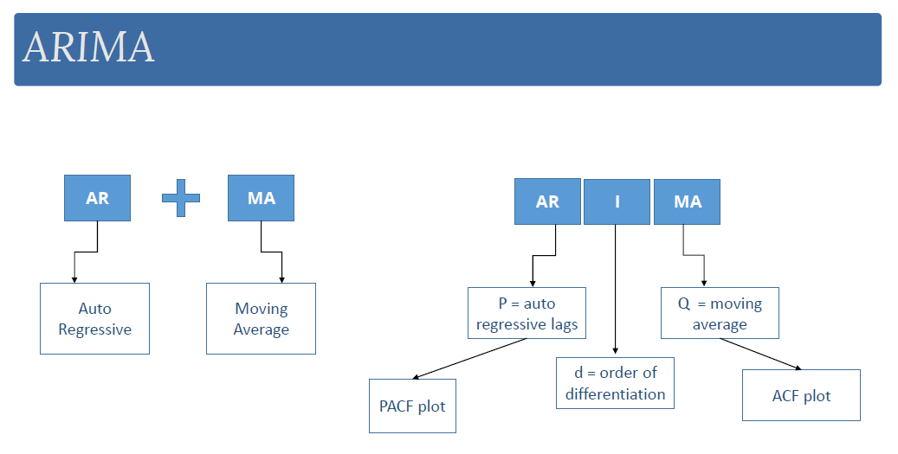

Slide 39
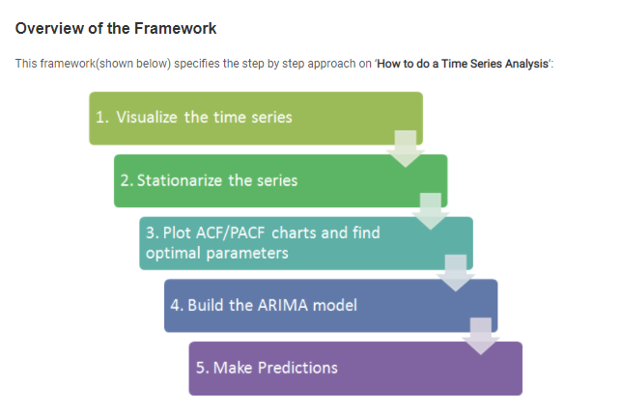
Reference Courtesy: Analytics Vidhya

Slide 40
Step 1: Visualize the Time Series
It is essential to analyze the trends prior to building any kind of time series model. The details we are interested in pertains to any kind of trend, seasonality or random behaviour in the series.
Step 2: Stationarize the Series
Once we know the patterns, trends, cycles and seasonality , we can check if the series is stationary or not. Dickey – Fuller is one of the popular test to check the same. What if the series is found to be non-stationary?
There are three commonly used technique to make a time series stationary:
1. Detrending : Here, we simply remove the trend component from the time series. For instance, the equation of my time series is:
x(t) = (mean + trend * t) + error
We’ll simply remove the part in the parentheses and build model for the rest.
2. Differencing : This is the commonly used technique to remove non-stationarity. Here we try to model the differences of the terms and not the actual term. For instance,
x(t) – x(t-1) = ARMA (p , q)
This differencing is called as the Integration part in AR(I)MA. Now, we have three parameters
p : AR
d : I
q : MA
3. Seasonality : Seasonality can easily be incorporated in the ARIMA model directly. More on this has been discussed in the applications part below.

Slide 41
Step 3: Find Optimal Parameters
The parameters p,d,q can be found using ACF and PACF plots. An addition to this approach is can be, if both ACF and PACF decreases gradually, it indicates that we need to make the time series stationary and introduce a value to “d”.
Step 4: Build ARIMA Model
With the parameters in hand, we can now try to build ARIMA model. The value found in the previous section might be an approximate estimate and we need to explore more (p,d,q) combinations. The one with the lowest BIC and AIC should be our choice. We can also try some models with a seasonal component. Just in case, we notice any seasonality in ACF/PACF plots.
Step 5: Make Predictions
Once we have the final ARIMA model, we are now ready to make predictions on the future time points. We can also visualize the trends to cross validate if the model works fine.

Slide 42
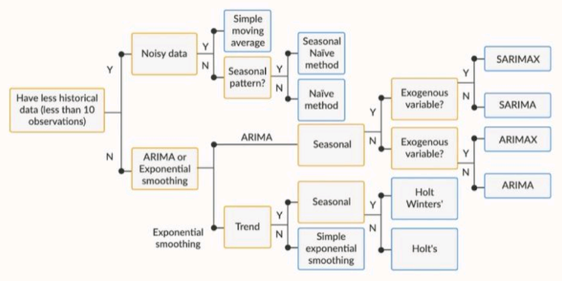
Flowchart for choosing the right Time Series Model

